Slide 1
Intellectual property rights
Chapter 13
CS449-Professional Issues in Information Technology
Course Instructor: Engr. Kanwal
Notes:
<number>

Slide 2
Chapter Outcome
After studying this chapter, you should:
be familiar with the main types of intellectual property right;
understand how these rights can be used to protect software;
be aware of the limitations of this protection;
understand the main issues in the continuing debate about software patents.
12/18/2018
FAST-NUCES CS449-PIT [Fall-2018]
<number>
Notes:
<number>

Slide 3
Introduction
If someone steals your bicycle, you no longer have it. If someone takes away a computer belonging to a company, the company no longer has it.
If you invent a drug that will cure all known illnesses and leave the formula on your desk, someone can come along, read the formula, remember it, and go away and make a fortune out of manufacturing the drug.
But you still have the formula even though the other person now has it as well. This shows that the formula or any piece of information is not property in the same way that a bicycle is.
12/18/2018
FAST-NUCES CS449-PIT [Fall-2018]
<number>
Notes:
<number>

Slide 4
Introduction….
The legal definition of theft involves taking away a piece of someone’s property with the intention to permanently deprive them of it. As we have just seen, this cannot apply to a piece of information.
Property such as bicycles or computers is called tangible property, that is, property that can be touched. It is protected by laws relating to theft and damage.
Property that is intangible is known as intellectual property. It is governed by a different set of laws, concerned with intellectual property rights, that is, rights to use, copy, or reveal information about intellectual property.
12/18/2018
FAST-NUCES CS449-PIT [Fall-2018]
<number>
Notes:
<number>

Slide 5
Introduction….
Intellectual property crosses national borders much more quickly than tangible property and the international nature of intellectual property rights has long been recognized.
The international law relating to trade marks and patents is based on the Paris Convention, which was signed in 1883. The Berne Convention, which is the basis of international copyright law, was signed in 1886.
Changes in technology & the commercial developments that follow them present the law with new problems. The law relating to intellectual property rights is evolving very rapidly and most of this evolution is taking place in a global or regional context
12/18/2018
FAST-NUCES CS449-PIT [Fall-2018]
<number>
Notes:
<number>

Slide 6
TYPES OF INTELLECTUAL PROPERTY RIGHTS
There are several different rights that relate to intellectual property relevant to software and the IS industry.
Following are the rights which may be used to protect different aspects of a piece of art, literature or software.
copyright
patents
confidential information
trade marks
design rights
moral rights.
12/18/2018
FAST-NUCES CS449-PIT [Fall-2018]
<number>
Notes:
<number>

Slide 7
Copyright
Copyright protects:
original literary, dramatic, musical and artistic works;
sound recordings, films, broadcasts and cable transmissions;
the typographical arrangement of published editions.
Things protected by Copyright are called "works".
12/18/2018
FAST-NUCES CS449-PIT [Fall-2018]
<number>
Notes:
<number>

Slide 8
Software copyright
The 1988 Copyright, Patents and Designs Act states that the phrase 'literary work" includes a table or compilation, a computer program and preparatory design material for a computer program
The EU directive 91/250 states that “Member States shall protect computer programs, by copyright, as literary works. For the purposes of this Directive, the term ‘computer programs’ shall include their preparatory design material.”
12/18/2018
FAST-NUCES CS449-PIT [Fall-2018]
<number>
Notes:
<number>

Slide 9
Owner’s rights
Copyright gives five exclusive rights to the owner of the copyright:
the right to copy the work;
the right to issue copies to the public;
the right to perform, play or show the work to the public;
the right to broadcast the work or transmit it on a cable service;
the right to make an adaptation of the work.
12/18/2018
FAST-NUCES CS449-PIT [Fall-2018]
<number>
Notes:
<number>

Slide 10
How long do the rights last?
In the EU, 70 years from the death of the author (in the case of a literary or artistic work, or software);
In USA, the same is true for works published after 2002, but can be 95 years after the date of publication in some cases, for earlier works;
In Canada, it is 50 years from the death of the author.
12/18/2018
FAST-NUCES CS449-PIT [Fall-2018]
<number>

Slide 11
Database right (Copyright and rights in databases regulations 1997)
If a database is the author’s “own original intellectual creation”, it is treated as a literary work and it is subject to the copyright protection.
If there has been “substantial investment in obtaining, verifying or presenting the contents of the database”, then it is also protected by the database right. (This lasts for 15 years, much less than copyright which is much longer than the database is likely to be useful.)
12/18/2018
FAST-NUCES CS449-PIT [Fall-2018]
<number>

Slide 12
Who owns the copyright?
Copyright is owned by the author(s) of the work except that:
If the author is an employee and the work is an original literary, dramatic, musical or artistic work created in the course of employment, then the copyright belongs to the employer.
12/18/2018
FAST-NUCES CS449-PIT [Fall-2018]
<number>
Notes:
<number>

Slide 13
Who owns the copyright? (cont)
An independent contractor is not an employee and so will own the copyright in work he does unless agreed otherwise.
Copyright can only be transferred in writing.
Copyright does not need to be registered. It comes into existence at the moment the work is recorded, in writing or otherwise.
12/18/2018
FAST-NUCES CS449-PIT [Fall-2018]
<number>
Notes:
<number>

Slide 14
Infringement of copyright
Anyone who, without consent, does any of the five things that are the exclusive right of the owner of the copyright has committed primary infringement of copyright.
Secondary infringement occurs when an infringement is performed knowingly and in the course of business.
Primary infringement is purely a civil matter. Secondary infringement can be a criminal offence.
12/18/2018
FAST-NUCES CS449-PIT [Fall-2018]
<number>
Notes:
<number>

Slide 15
Registering Copyright
In Britain and Europe, full copyright protection comes into effect immediately, when the work is ‘fixed’, i.e. recorded in some form.
In the USA, protection is very limited unless copyright has been registered with the US Copyright Office.
12/18/2018
FAST-NUCES CS449-PIT [Fall-2018]
<number>

Slide 16
When is a copy a “copy”?
Copyright is breached by copying ‘the whole or a substantial part of the work’.
‘Substantial’ can also mean just a key part, which could be quite small.
Non-literal copying, e.g. using the same design to produce a similar system written in a different language.
12/18/2018
FAST-NUCES CS449-PIT [Fall-2018]
<number>

Slide 17
Licensing
A license allows (the licensee), to use a work for some or all purposes but the owner retains ownership.
Licenses can be exclusive or non-exclusive.
The license may be for a fixed period or it may be in perpetuity.
In an assignment, the copyright owner transfers some or all of the rights of ownership to someone else (the assignee).
12/18/2018
FAST-NUCES CS449-PIT [Fall-2018]
<number>
Notes:
<number>

Slide 18
Examples of licences
Retail software: a licence is perpetuity to use one copy of the software on a computer of your choice. Non-exclusive.
Professional packages: one year licence, renewable, to run the software on a server with a specified maximum number of simultaneous users. Non-exclusive.
Marketing agreements: exclusive licence to sell sub-licences in a specified geographical area.
12/18/2018
FAST-NUCES CS449-PIT [Fall-2018]
<number>

Slide 19
Open source licences / free software
An open source licence allows the source code to be used, modified or shared, subject to certain conditions. It is not necessarily free.
Free software can be used without payment, but the source code may not be necessarily available, and modifying it may not be permitted.
12/18/2018
FAST-NUCES CS449-PIT [Fall-2018]
<number>
Notes:
<number>

Slide 20
Assignment
Copyright may be assigned for a limited or unlimited period. It may be assigned for future works as well.
Assignments must be in writing and signed by the copyright owner.
12/18/2018
FAST-NUCES CS449-PIT [Fall-2018]
<number>
Notes:
<number>

Slide 21
What you can do
fair dealing, copying for:
private study or research;
criticism or review
reporting current events
making back-up copies
error correction.
12/18/2018
FAST-NUCES CS449-PIT [Fall-2018]
<number>
Notes:
<number>

Slide 22
How can copyright owners enforce their rights?
Search and Seizure;
Injunctions – court orders restraining people from infringing copyright;
Claim damages;
Claim for profits.
Large Companies who own copyright, often prevent illegal publication of copies by threatening action or suing, that a small publisher cannot afford to defend.
12/18/2018
FAST-NUCES CS449-PIT [Fall-2018]
<number>[E-1]
Notes:
<number>

Slide 23
Patents
A patent is a temporary right, granted by the state, enabling an inventor to prevent other people from exploiting his invention without his permission.
Unlike copyright, it does not come into existence automatically; the inventor must apply for the patent to be granted.
However, the protection it gives is much stronger than copyright, because the grant of a patent allows the person owning it (the patentee) to prevent anyone else from exploiting the invention, even if they have discovered it for themselves.
12/18/2018
FAST-NUCES CS449-PIT [Fall-2018]
<number>

Slide 24
Patents….
Patents were originally intended to encourage new inventions, and in particular to encourage the disclosure of those new inventions.
Inventors are often hesitant to reveal the details of their invention, for fear that someone else might copy it.
A government-granted temporary monopoly on the commercial use of their invention provides a remedy for this fear, and so acts as an incentive to disclose the details of the invention.
After the monopoly period expires, everyone else is free to practice the invention. And because of the disclosure made by the inventor, it is very easy to do so.
12/18/2018
FAST-NUCES CS449-PIT [Fall-2018]
<number>

Slide 25
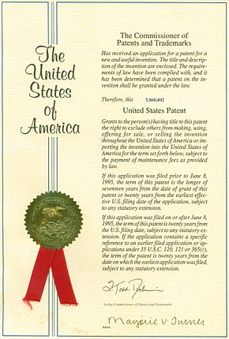
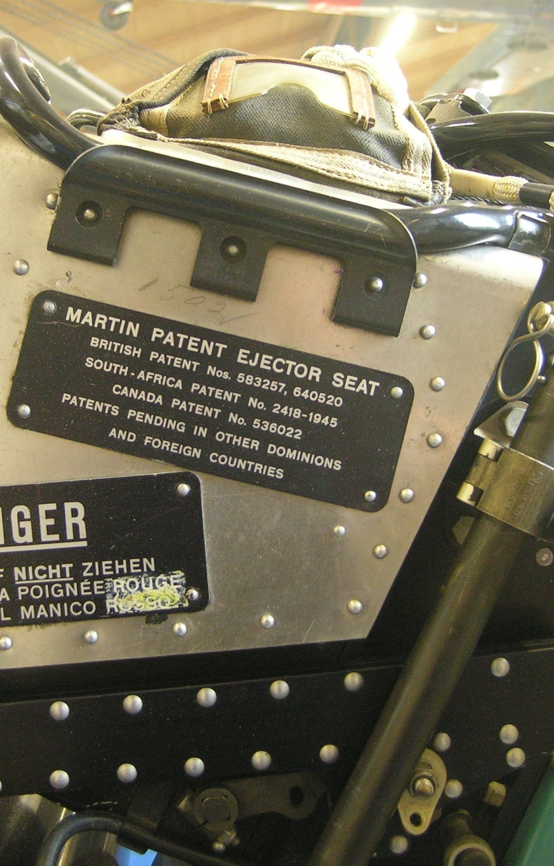
Patents….
12/18/2018
FAST-NUCES CS449-PIT [Fall-2018]
<number>

Slide 26
Patents….
Patent may only be granted if:
The invention is new
It involves an inventive step
It is capable of industrial application
The subject matter of the invention does not fall within an excluded class
12/18/2018
FAST-NUCES CS449-PIT [Fall-2018]
<number>

Slide 27
Excluded class
A scientific theory e.g. law of physics cannot be patented.
A mathematical method e.g. method of calculating a square root.
A literary work, dramatic, musical or artistic work.
12/18/2018
FAST-NUCES CS449-PIT [Fall-2018]
<number>

Slide 28
Parts of the patent
Typical patent includes:
INID Codes(Internationally agreed Numbers for the Identification): international system that allows elements on the patent cover page to be identified in all languages
Claims - phrases that precisely define the invention and outline the boundaries of the claimed invention (prevents infringement)
12/18/2018
FAST-NUCES CS449-PIT [Fall-2018]
<number>
Notes:
<number>

Slide 29
Patents….
Patent holders receive exclusive rights to make, use, or sell a utility, design, or plant.
The patentee must file a detailed description of the invention which is published by the government.
Public disclosure provides a reservoir of technical information.
Some companies prefer to protect their inventions called Trade Secrets kept private to maintain a company’s competitive advantage.
12/18/2018
FAST-NUCES CS449-PIT [Fall-2018]
<number>

Slide 30
Types of patents
Utility patents which may be granted to anyone who invents a machine, vital process, composition of matter, article of manufacture or any useful improvement thereof.
Design patents may be granted to anyone who creates a new, original design for an article of manufacture
Plant patents may also be granted to anyone who creates or discovers or reproduce any distinct and new variety of plant (Genetic Modification).
12/18/2018
FAST-NUCES CS449-PIT [Fall-2018]
<number>

Slide 31
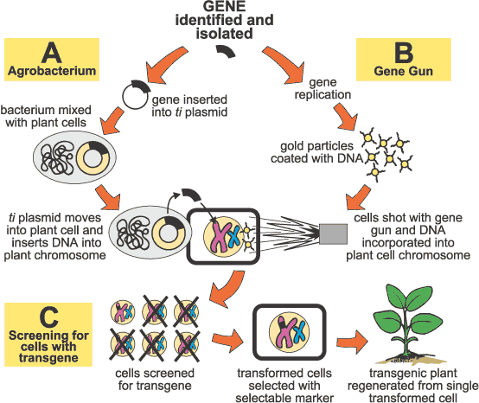
Example
12/18/2018
FAST-NUCES CS449-PIT [Fall-2018]
<number>

Slide 32
TRADEMARKS AND TRADE NAMES
A trademark is a word, phrase, symbol or design, or a combination of words, phrases, symbols or designs, that identifies and distinguishes the source of the goods of one party from those of others.
Examples – Reebok, Mc Donald’s, Nike, Levis etc.
The Trade Marks law is contained in Trade Marks Act, 1999
12/18/2018
FAST-NUCES CS449-PIT [Fall-2018]
<number>

Slide 33





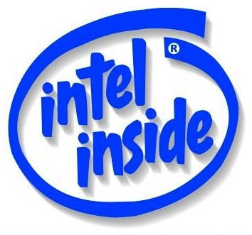



TRADEMARKS

Slide 34
TRADEMARKS
Trademarks must be clear and distinct from each other
Trademark may also be three-dimensional (e.g. neck of bottle)
Comparative advertising is allowed
To register a trade mark , the mark must be:-
distinctive, and, not deceptive, or contrary to law or morality, and,
It must not be identical or similar to any earlier marks for the same or similar goods.
12/18/2018
FAST-NUCES CS449-PIT [Fall-2018]
<number>

Slide 35

Trademarks can be …
words
Coca Cola
phrases
“Have it your way”
symbols
sounds
12/18/2018
FAST-NUCES CS449-PIT [Fall-2018]
<number>[E-2]

Slide 36
Trademark Numbers(586)
Intel learned that they cannot trademark numbers themselves
Pentium can be trademarked
You can trademark
7-Up
Three-peat (winning three consecutive championships)
12/18/2018
FAST-NUCES CS449-PIT [Fall-2018]
<number>

Slide 37
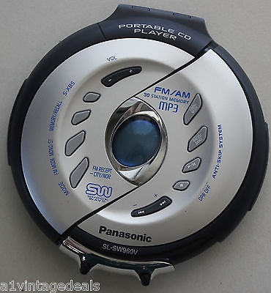
CD PLAYER
Music played on the CD player is protected by copyright
Industrial design protection for 3D shape
Various technical parts & mechanisms are subject mater of protection under Patents
Brand name registered under trademark
12/18/2018
FAST-NUCES CS449-PIT [Fall-2018]
<number>
Notes:
<number>

Slide 38
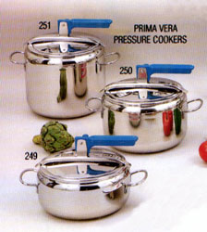
FOR MOST PRODUCTS EVERY FORM OF INTELLECTUAL PROPERTY RIGHTS CAN BE OBTAINED
← Pressure Cooker
“PATENT” → For every individual improved mechanism
“DESIGN” → For outer shape & Contour / Configuration
“TRADE MARK”→ Brand name or Logo for goods denoted as ®
“Copy right”→ For Instruction / manual booklet denoted as ©
12/18/2018
FAST-NUCES CS449-PIT [Fall-2018]
<number>
Notes:
<number>

Slide 39
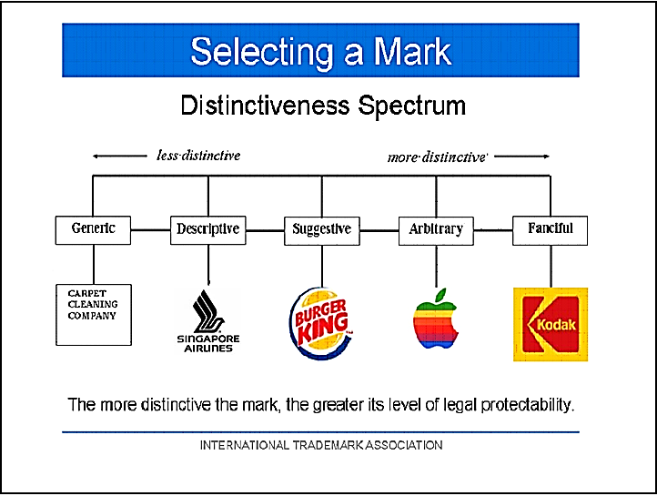
Selection
12/18/2018
FAST-NUCES CS449-PIT [Fall-2018]
<number>
Notes:
<number>

Slide 40
Selecting a Mark!
(a) Generic terms: common name of the article or services to which they are applied.
They are not protectable as stand alone trademarks. (Examples: computer, automobile, shuttle.)
12/18/2018
FAST-NUCES CS449-PIT [Fall-2018]
<number>

Slide 41
Selecting a Mark!
(b) Suggestive Marks: suggest, rather than describe, the goods or services or some characteristic thereof. Consumer must use imagination or hindsight to understand the connection.
Although suggestive marks are self-advertisers and, thus, easier to promote than arbitrary marks, they are subject to more conflict and may be afforded a narrower scope of protection.
Thus, while KODAK has no competition from any mark anywhere close to it, BURGER KING must coexist with WHATABURGER and other restaurants that use the word BURGER.
12/18/2018
FAST-NUCES CS449-PIT [Fall-2018]
<number>

Slide 42
Selecting a Mark!
(c) Arbitrary Marks: created from existing words, but have no meaning in relation to the goods or services with which they are used. Fanciful and arbitrary marks are easier to protect but can be more expensive to promote. (Examples: APPLE for computers and TIDE for detergent).
(d) Fanciful Marks: created from words that are coined or made up, and have no meaning in relation to the goods or services. (Examples: KODAK for film and EXXON for petroleum products).
12/18/2018
FAST-NUCES CS449-PIT [Fall-2018]
<number>

Slide 43
Difference between TM & SM
A trademark is the brand name of the goods
A service mark, just as the name implies, identifies the name, logo, device or a combination of these to differentiate the service provided by one business to that of the others.
The main difference between service mark and trademark is that trademark is applicable for use only to identify products or goods produced by a business. On the other hand, a service mark is used to exclusively identify a service.
12/18/2018
FAST-NUCES CS449-PIT [Fall-2018]
<number>

Slide 44
Examples of Service Marks and Trademarks
Examples of businesses that use Service Marks (SM) are banking, insurance & transportation services etc.
12/18/2018
FAST-NUCES CS449-PIT [Fall-2018]
<number>

Slide 45

b
12/18/2018
FAST-NUCES CS449-PIT [Fall-2018]
<number>

Slide 46
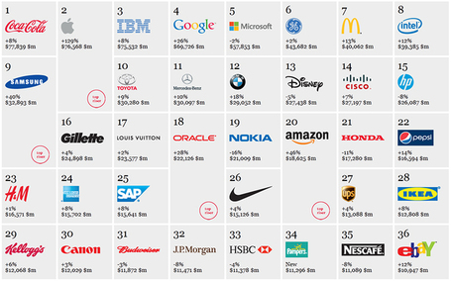
Top 100 Global Brands of 2017 « Branding Magazine
12/18/2018
FAST-NUCES CS449-PIT [Fall-2018]
<number>

Slide 47
Domain Names
ICANN [Internet Corporation for Assigned Names and Numbers] is an internationally organized, non-profit making corporation. Its main responsibility is ensuring the ‘universal resolvability’ of internet addresses.
That is, ensuring that the same domain name will always lead to the same internet location wherever it is used from and whatever the circumstances.
In practice, ICANN delegates the responsibility for assigning individual domain names to other bodies, subject to strict rules.
12/18/2018
FAST-NUCES CS449-PIT [Fall-2018]
<number>

Slide 48
Domain Names…..
Domain names were originally meant to be used just as a means of simplifying the process of connecting one computer to another over the internet.
However, because they are easy to remember, they have come to be used as a way of identifying businesses. Indeed, they are frequently used in advertising.
Conversely, it is not surprising that companies would want to use their trade marks or their company names as their internet domain names.
12/18/2018
FAST-NUCES CS449-PIT [Fall-2018]
<number>

Slide 49
Domain Names…..
The potential for conflict between trade marks and domain names is inherent in the two systems. Trade marks are registered with public authorities on a national or regional basis.
The owner of the trade mark acquires rights over the use of the trade mark in a specific country or region. Identical trade marks may be owned by different persons in respect of different categories of product.
12/18/2018
FAST-NUCES CS449-PIT [Fall-2018]
<number>

Slide 50
Domain Names…..
Domain names are usually allocated by a private organization and are globally unique; they are normally allocated on a first come, first served basis.
This means that if different companies own identical trade marks for different categories of product or for different geographical areas, only one of them can have the trade mark as domain name, and that will be the one who has applied first.
12/18/2018
FAST-NUCES CS449-PIT [Fall-2018]
<number>

Slide 51
Domain Names…..
The inconsistencies between two different systems of registration has made it possible for people to register, with their own domain names, for the trade marks belonging to some other company.
This is sometimes known as cyber squatting. They then offer to sell these domain names to the owner of the trade mark at an inflated price.
It is usually cheaper and quicker for the trade mark owner to pay up than to pursue legal remedies, even when these are available.
12/18/2018
FAST-NUCES CS449-PIT [Fall-2018]
<number>

Slide 52
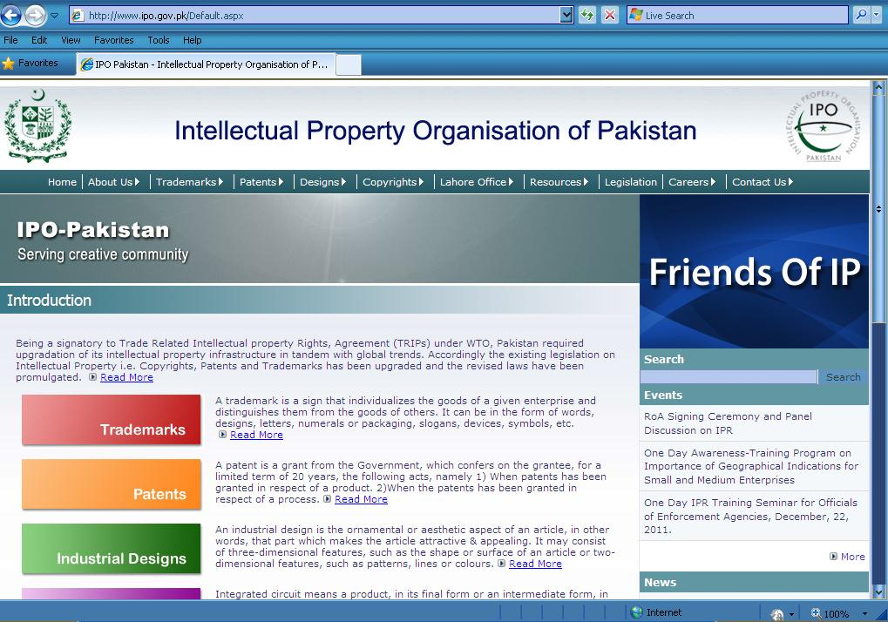
www.ipo.gov.pk
12/18/2018
FAST-NUCES CS449-PIT [Fall-2018]
<number>

